Slide 1
Samin Shahriar Tokey
14.02.04.066

Slide 2
Assignment 3
Smartphone Price Prediction Through Their Benchmark Scores , Camera Rating And Release Date

Slide 3
Features
Geekbench Single Core Score
Geekbench Multi Core Score
DxO Mark Camera Rating
Release Date
Price (The One We Want To Predict)

Slide 4
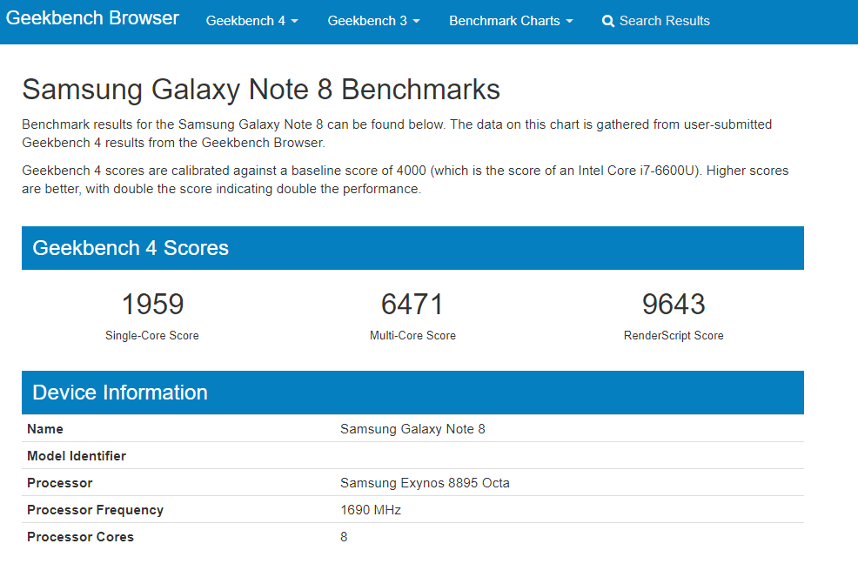
Benchmark Ratings

Slide 5
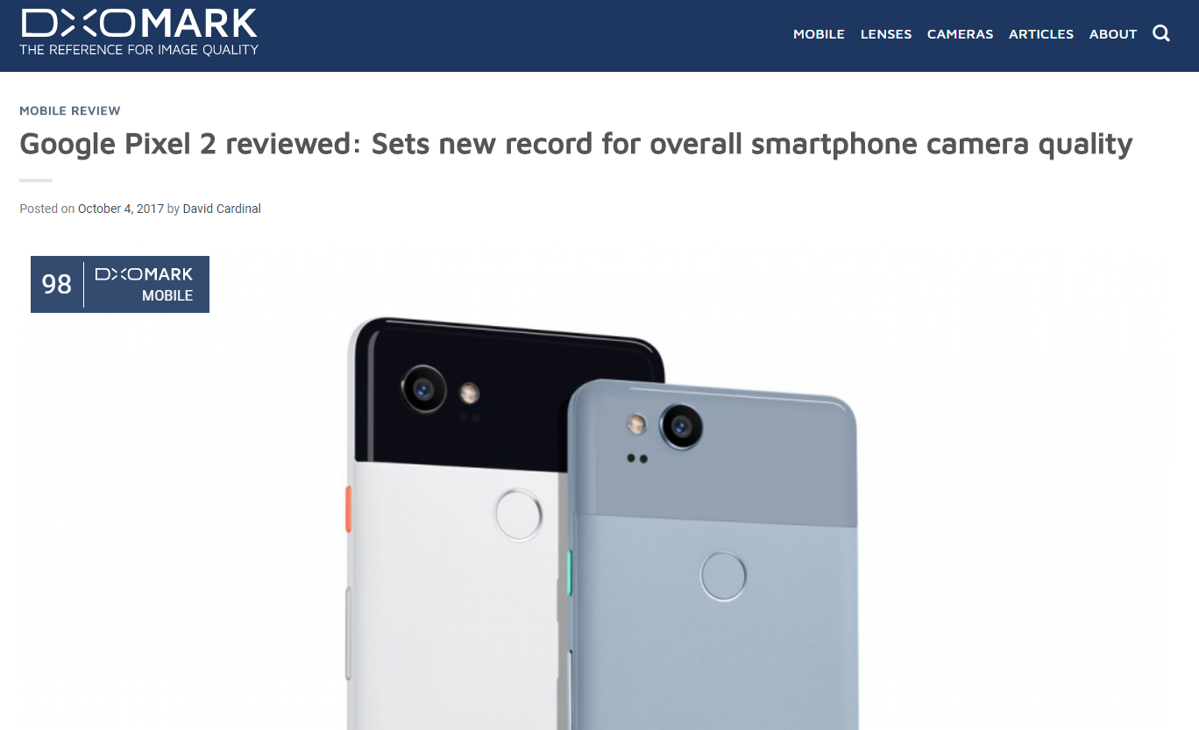
Camera Rating

Slide 6
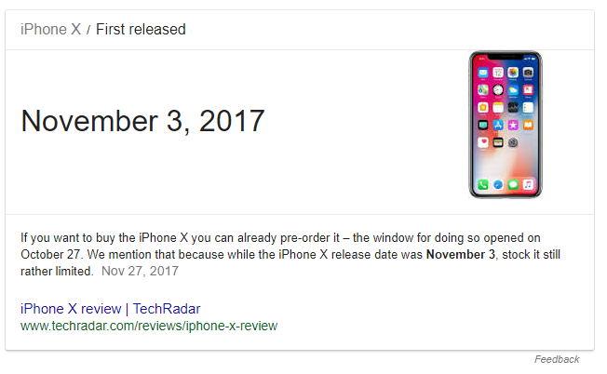
Release Date

Slide 7
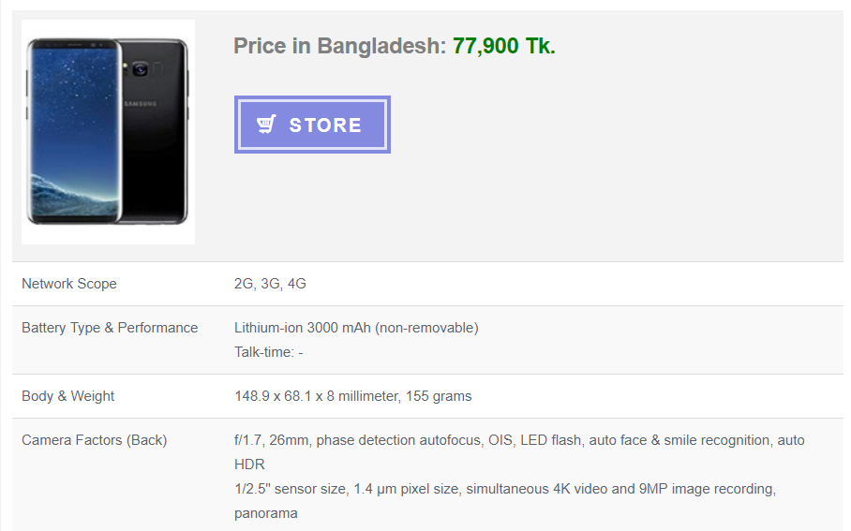
Price In BDT

Slide 8
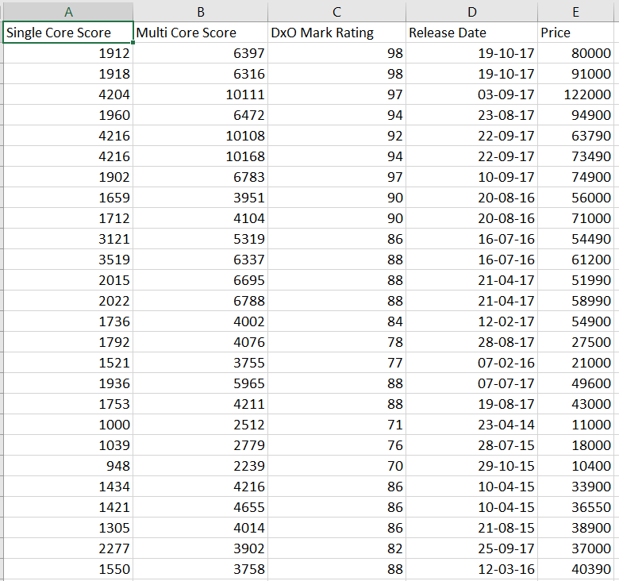
The Dataset

Slide 9
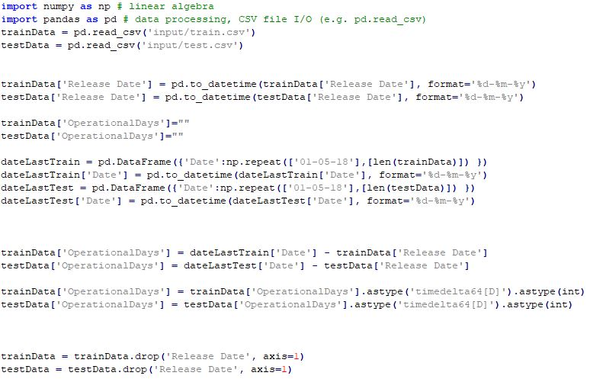
Input and Deriving Operational Days From Release Date

Slide 10
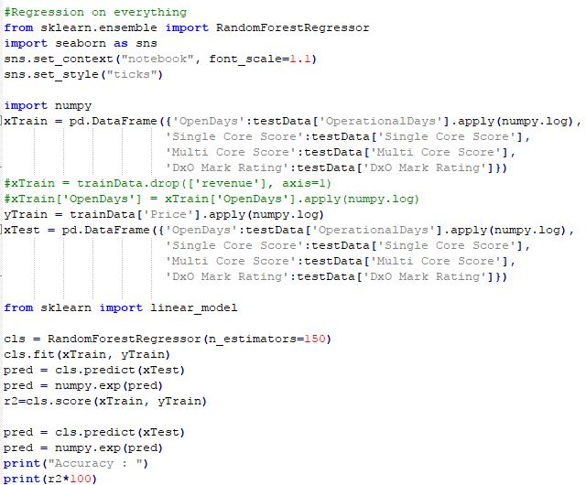
Regression and Fitting Data

Slide 11
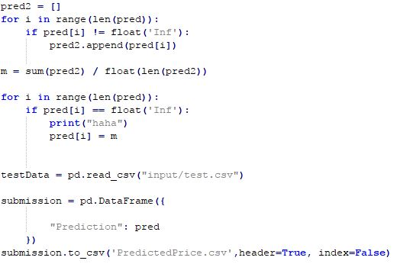
Normalizing Values & Generating Output

Slide 12
Thank You

